Slide 1
Topic
Some Examples of Neural Networks

Slide 2
Concepts Covered:
Multi-Layer Feed-Forward Neural Networks
Radial Basis Function Networks
Recurrent Neural Networks
Self-Organizing Map

Slide 3
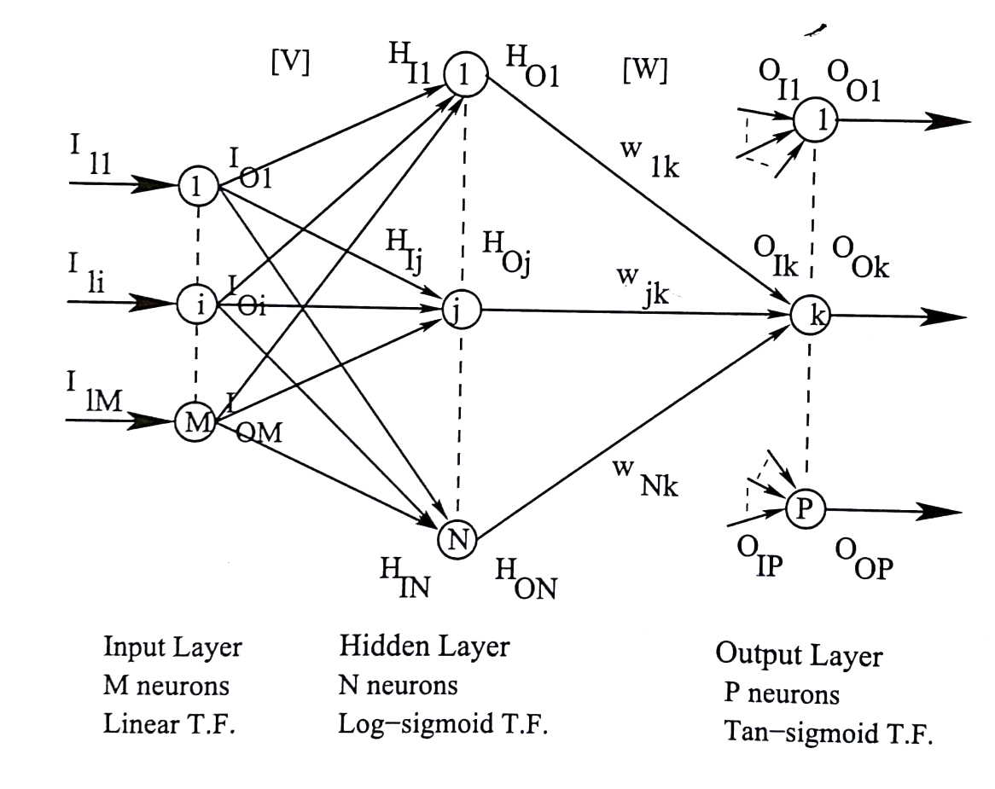
Multi-Layer Feed-Forward Neural Network (MLFFNN)
I_{I1}: Input of 1-st neuron lying on input layer
I_{O1}: Output of 1-st neuron lying on input layer

Slide 4
V₁₁ . . . . V_{1j} . . . .V_{1N}
. . .
. . .
[V] = V_{i1} . . . . V_{ij} . . . . V_{iN}
. . .
. . .
V_{M1} . . . .V_{Mj} . . .V_{MN}
W₁₁ . . . . W_{1K} . . . . W_{1P}
. . .
. . .
[W] = W_{j1} . . . . W_{jK} . . . . .W_{jP}
. . .
. . .
W_{N1} . . . . W_{Nk} . . . . W_{NP}

Slide 5
Forward Calculations
Step 1:
Step 2:
Determination of the outputs of input layer
I_{Oi} = I_{Ii},
where i = 1, 2, . . . . ., M
Calculation of inputs of hidden layer
H_{Ij} = v_{1j} I_{O1} + . . . . .+ v_{ij} I_{Oi} + ……+ v_{Mj} I_{OM},
where j = 1, 2, . . . . . , N
Determination of the outputs of hidden neurons

Slide 6
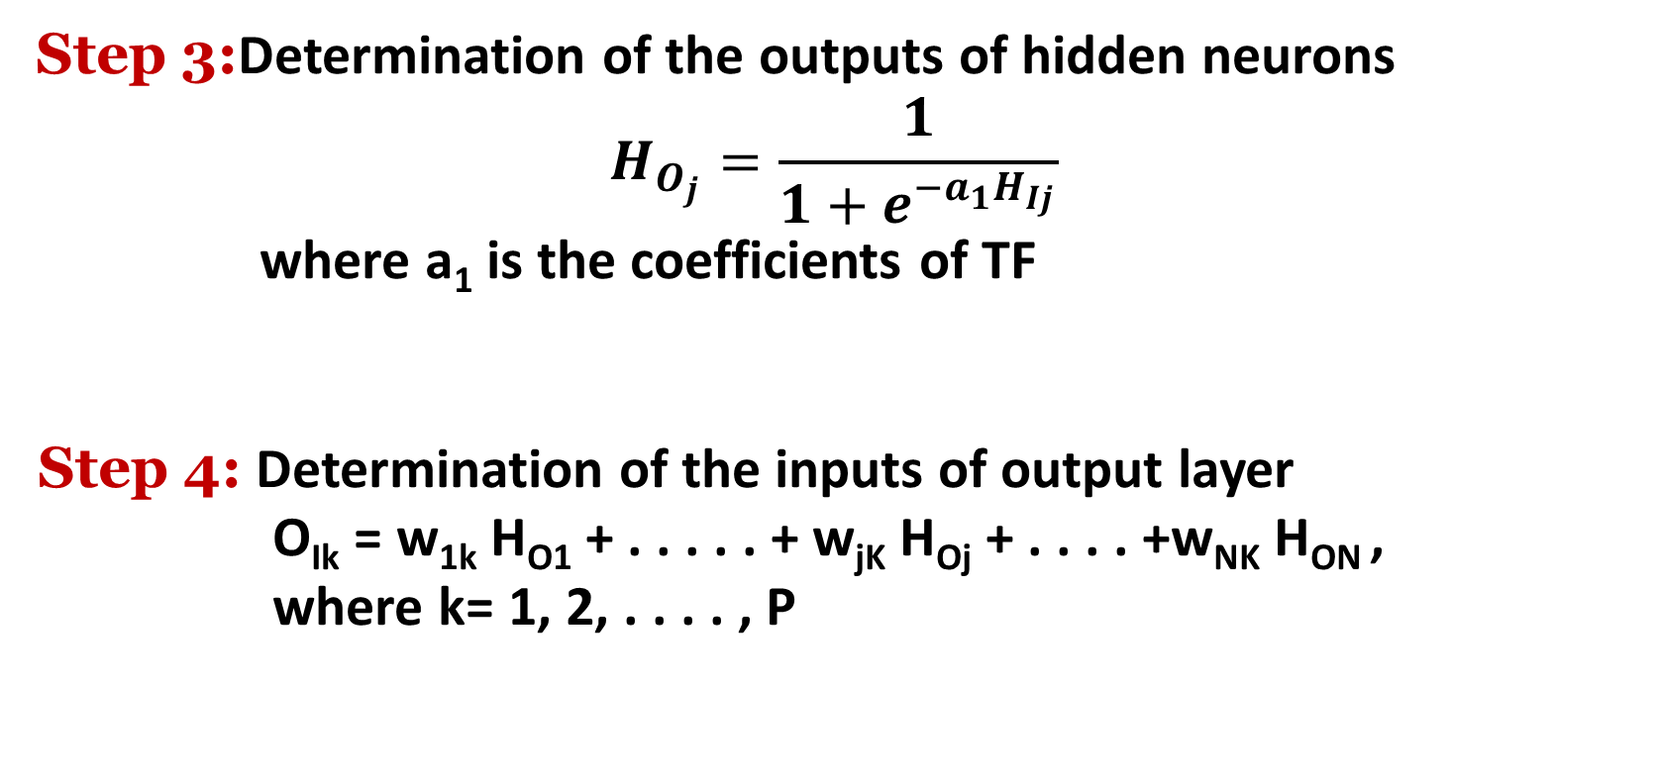
Step 3:Determination of the outputs of hidden neurons
$$H_{O_{j}}=\frac{1}{1+e^{−a_{1}H_{Ij}}}$$
where a₁ is the coefficients of TF
Step 4: Determination of the inputs of output layer
O_{Ik} = w_{1k} H_{O1} + . . . . . + w_{jK} H_{Oj} + . . . . +w_{NK} H_{ON} ,
where k= 1, 2, . . . . , P

Slide 7
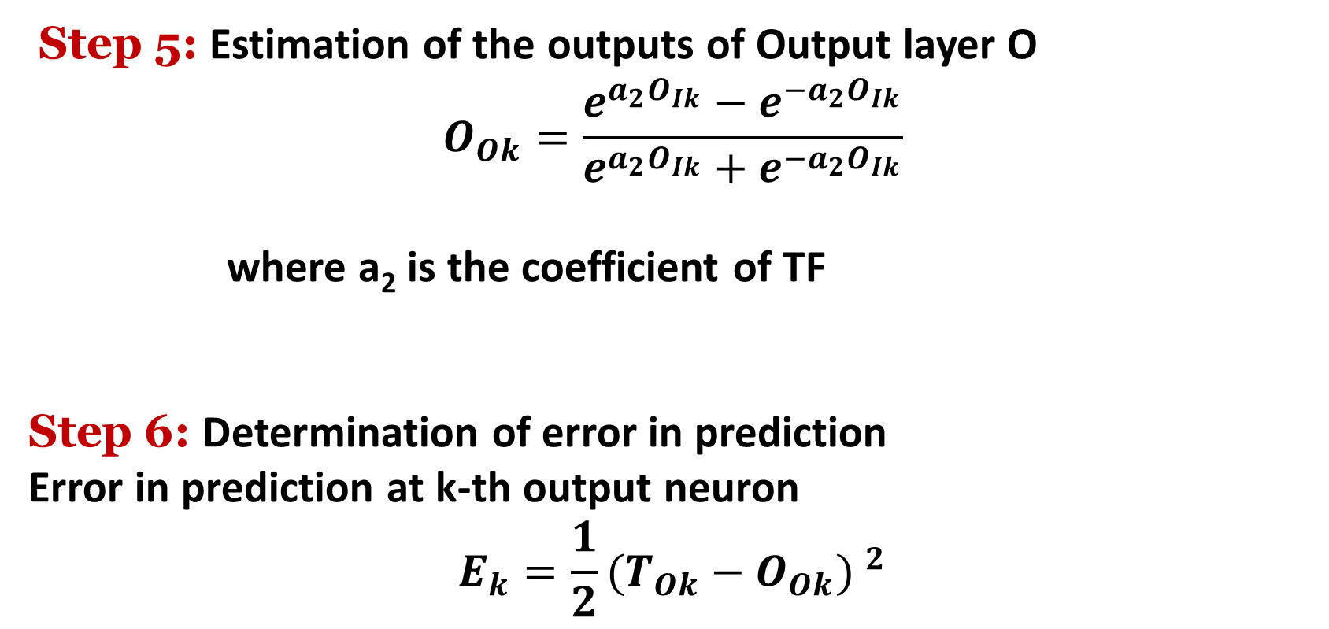
Step 5: Estimation of the outputs of Output layer O
$$O_{Ok}=\frac{e^{a_{2}O_{Ik}}−e^{−a_{2}O_{Ik}}}{e^{a_{2}O_{Ik}}+e^{{−a}_{2}O_{Ik}}}$$
where a₂ is the coefficient of TF
Step 6: Determination of error in prediction
Error in prediction at k-th output neuron
$$E_{k}=\frac{1}{2}{(T_{Ok}−O_{Ok}) }^{2}$$

Slide 8
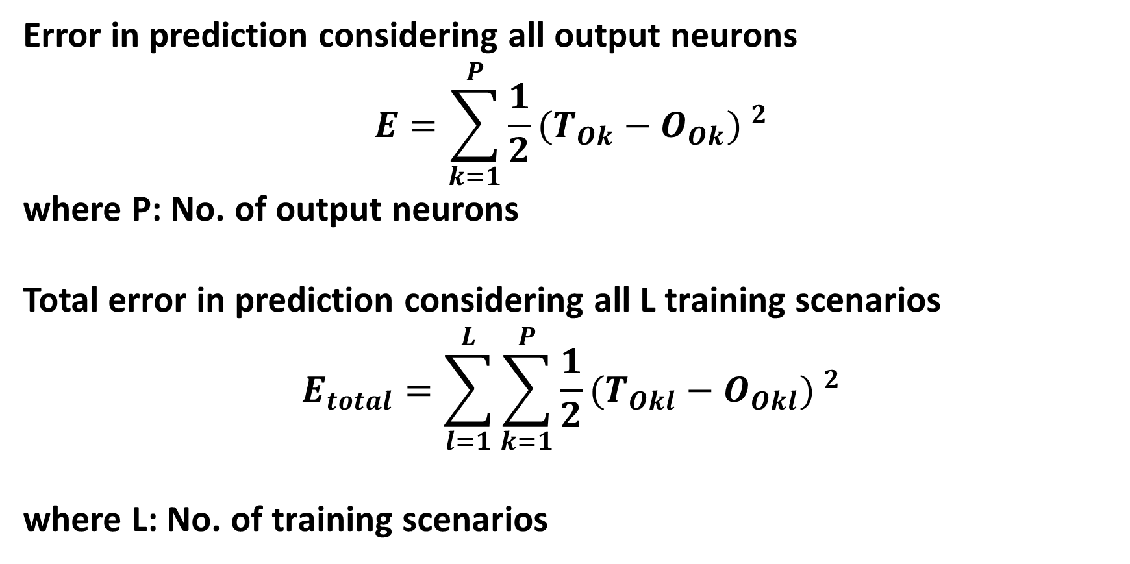
Error in prediction considering all output neurons
$$E=\sum_{k=1}^{P}{\frac{1}{2}{(T_{Ok}−O_{Ok}) }^{2}}$$
where P: No. of output neurons
Total error in prediction considering all L training scenarios
$$E_{total}=\sum_{l=1}^{L}{\sum_{k=1}^{P}{\frac{1}{2}{(T_{Okl}−O_{Okl}) }^{2}}}$$
where L: No. of training scenarios

Slide 9
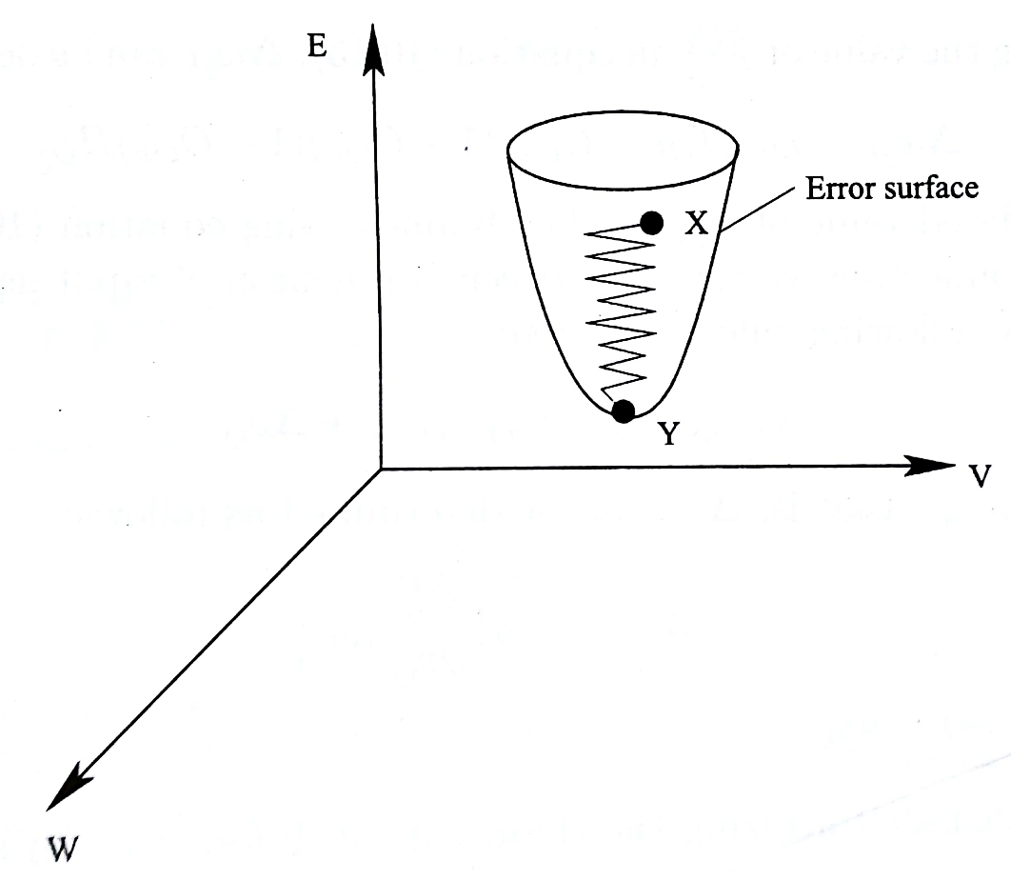
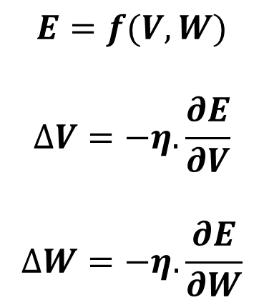
Back-Propagation Algorithm
Delta Rule
$$E=f(V,W)$$
$$∆V=−η.\frac{∂E}{∂V}$$
$$∆W=−η.\frac{∂E}{∂W}$$

Slide 10
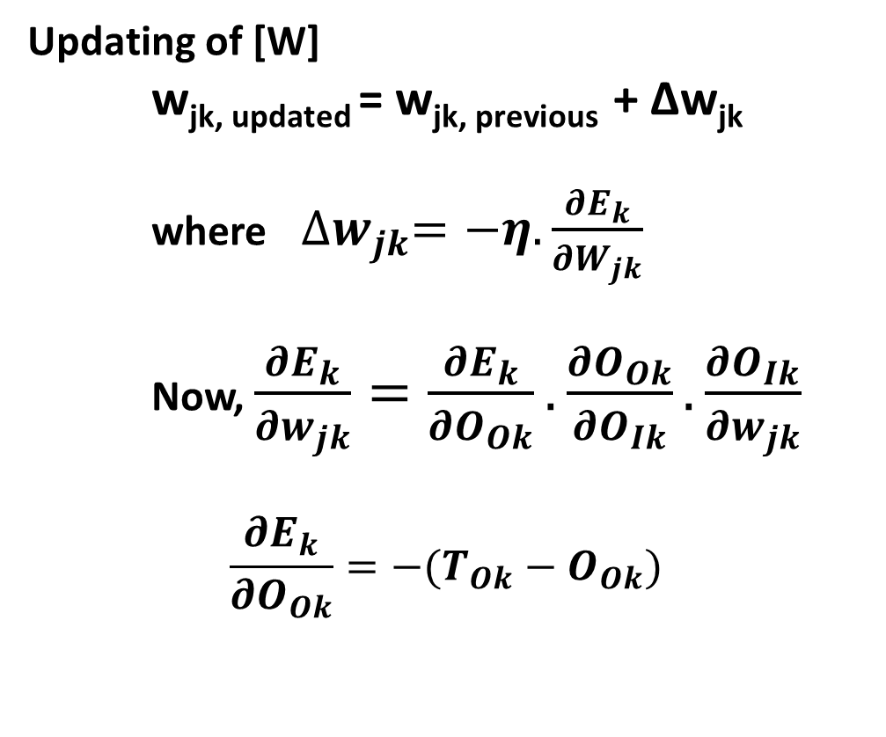
Incremental Mode of Training
Updating of [W]
w_{jk, updated} = w_{jk, previous} + Δw_{jk}
where${∆w}_{jk}=−η.\frac{{∂E}_{k}}{{∂W}_{jk}}$
Now, $\frac{{∂E}_{k}}{{∂w}_{jk}}=\frac{{∂E}_{k}}{{∂O}_{Ok}}.\frac{{∂O}_{Ok}}{{∂O}_{Ik}}.\frac{{∂O}_{Ik}}{{∂w}_{jk}}$
$$\frac{{∂E}_{k}}{{∂O}_{Ok}}=−(T_{Ok}−O_{Ok})$$

Slide 11


$$\frac{∂O_{Ok}}{∂O_{Ik}}=a_{2}(1+O_{Ok})(1−O_{Ok})$$
$$\frac{∂O_{Ik}}{∂w_{jk}}=H_{Oj}$$
$$\frac{∂E_{k}}{∂w_{jk}}=− (T_{Ok}−O_{Ok})a_{2}(1+O_{Ok})(1−O_{Ok})H_{Oj}$$
$${∆w}_{jk}=ηa_{2}(T_{Ok}−O_{Ok})(1+O_{Ok})(1−O_{Ok})H_{Oj}$$

Slide 12
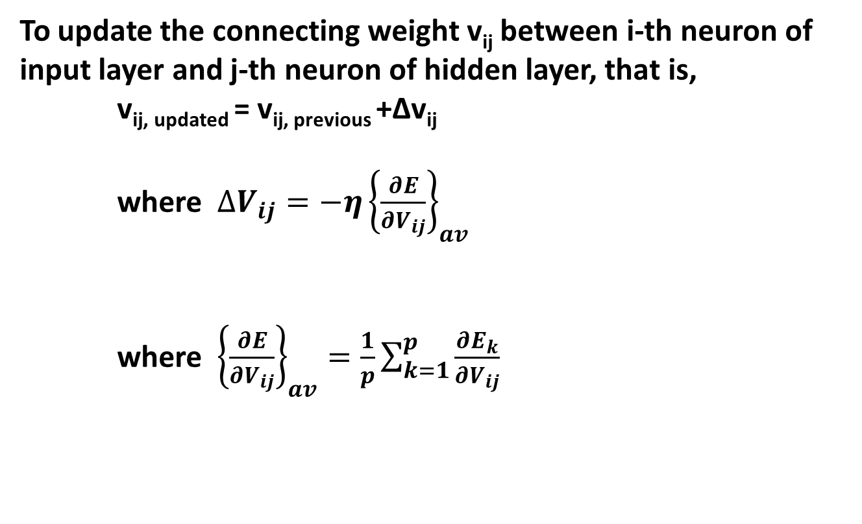
To update the connecting weight v_{ij} between i-th neuron of input layer and j-th neuron of hidden layer, that is,
v_{ij, updated} = v_{ij, previous} +Δv_{ij}
where $∆V_{ij}=−η{\left\{\frac{∂E}{∂V_{ij}}\right\}}_{av}$
where ${\left\{\frac{∂E}{∂V_{ij}}\right\}}_{av}=\frac{1}{p}\sum_{k=1}^{p}{\frac{∂E_{k}}{∂V_{ij}}}$

Slide 13
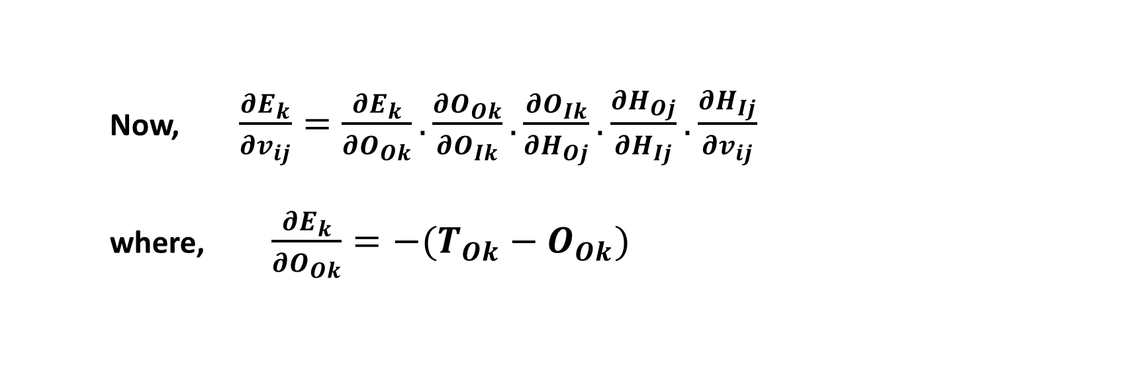

Now, $\frac{{∂E}_{k}}{{∂v}_{ij}}=\frac{{∂E}_{k}}{{∂O}_{Ok}}.\frac{{∂O}_{Ok}}{{∂O}_{Ik}}.\frac{{∂O}_{Ik}}{{∂H}_{Oj}}.\frac{{∂H}_{Oj}}{{∂H}_{Ij}}.\frac{{∂H}_{Ij}}{{∂v}_{ij}}$
where, $\frac{{∂E}_{k}}{{∂O}_{Ok}}=−(T_{Ok}−O_{Ok})$
$$\frac{∂O_{Ok}}{∂O_{Ik}}=a_{2}(1+O_{Ok})(1−O_{Ok})$$

Slide 14



$$\frac{∂O_{Ik}}{∂H_{Oj}}=w_{jk}$$
$$\frac{∂H_{Oj}}{∂H_{Ij}}=a_{1}H_{Oj}(1−H_{Oj})$$
$$\frac{∂H_{Ij}}{∂v_{ij}}=I_{Oi}=I_{Ii}$$
We get
$$\frac{∂E_{k}}{∂v_{ij}}={−a}_{1}a_{2}(T_{Ok}−O_{Ok})(1+O_{Ok})(1−O_{Ok})(1−H_{Oj})w_{jk}H_{Oj}I_{Ii}$$

Slide 15



Batch Mode of Training:
Let us consider L training scenarios. Mean Squared Deviation in prediction for k-th output neuron
The change in w_{jk} , that is , Δw_{jk} is determined as follows:
Now,
$$E^{′}=\frac{1}{2}.\frac{1}{L}\sum_{l=1}^{L}{{(T_{Okl}−O_{Okl})}^{2}}$$
$${∆w}_{jk}=−η.\frac{∂E^{′}}{∂w_{jk}}$$
$$\frac{∂E^{′}}{∂w_{jk}}=\frac{∂E^{′}}{∂E_{l}}.\frac{∂E_{l}}{∂E_{k}}.\frac{∂E_{k}}{∂O_{Ok}}.\frac{∂O_{Ok}}{∂O_{Ik}}.\frac{∂O_{Ik}}{∂w_{jk}}$$

Slide 16

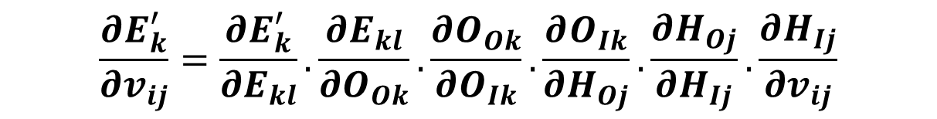

Similarly, Δv_{ij} can be calculated as follows:
Where
Now,
$${∆v}_{ij}=−η.{\left\{\frac{∂E^{′}}{∂v_{ij}}\right\}}_{av}$$
$${\left\{\frac{∂E^{′}}{∂v_{ij}}\right\}}_{av}=\frac{1}{p}\sum_{k=1}^{p}{\frac{∂E_{k}^{′}}{∂v_{ij}}}$$
$$\frac{∂E_{k}^{′}}{∂v_{ij}}=\frac{∂E_{k}^{′}}{∂E_{kl}}.\frac{∂E_{kl}}{∂O_{Ok}}.\frac{∂O_{Ok}}{∂O_{Ik}}.\frac{∂O_{Ik}}{∂H_{Oj}}.\frac{∂H_{Oj}}{∂H_{Ij}}.\frac{∂H_{Ij}}{∂v_{ij}}$$

Slide 17

Momentum Constant (α’)
Generalized Delta Rule:
$$∆w\left(t\right)=−η\frac{∂E}{∂w}\left(t\right)+α^{′}∆w\left(t−1\right)$$
η: (0.0 to 1.0)
α': (0.0 to 1.0)
α' is used to ensure a stable network even at a higher value of learning rate η

Slide 18
Notes:
BP algorithm → there is a chance of local minima problem
BP algorithm → transfer functions are to be differentiable in nature
BPNN may not be able to capture the dynamics of a highly dynamic process
Inputs are normalized
Connecting weights lie in the range of either (0.0, 1.0) or (-1.0,1.0)
Convergence Criterion: Absolute value of the rate of change of error in prediction becomes less than or equal to a pre-specified value
A neural network can be either fully-connected or partially-connected one

Slide 19
Multi-Layer Feed-Forward Neural Network (MLFFNN)
I_{I1}: Input of 1-st neuron lying on input layer
I_{O1}: Output of 1-st neuron lying on input layer

Slide 20
Advantages of BPNN
Can handle a problem having many variables
May not require so much problem information as that is needed for an FLC
Disadvantages of BPNN
Solutions of BPNN may get stuck at the local minima
Training of NN is more involved computationally compared to that of FLC
It works like a black box

Slide 21
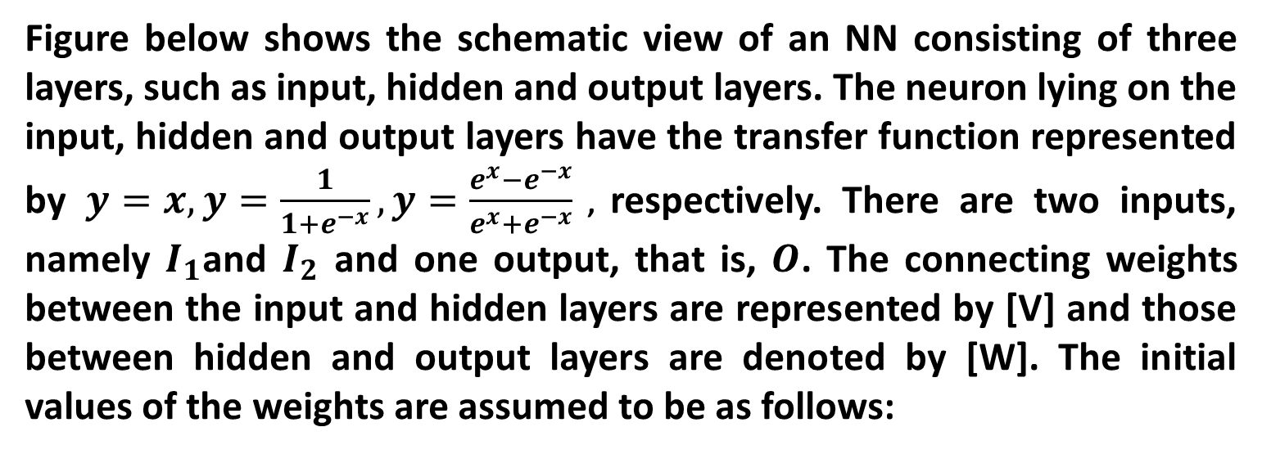
Numerical Example
Figure below shows the schematic view of an NN consisting of three layers, such as input, hidden and output layers. The neuron lying on the input, hidden and output layers have the transfer function represented by $y=x,y=\frac{1}{1+e^{−x}},y=\frac{e^{x}−e^{−x}}{e^{x}+e^{−x}}$ , respectively. There are two inputs, namely $I_{1}$and $I_{2}$ and one output, that is, $O$. The connecting weights between the input and hidden layers are represented by [V] and those between hidden and output layers are denoted by [W]. The initial values of the weights are assumed to be as follows:

Slide 22
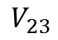
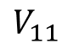
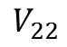
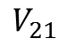
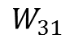
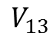
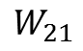
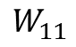
[V]
[W]
1
$$V_{11}$$
$$V_{21}$$
$$W_{11}$$
I₁
1
$$V_{12}$$
$$W_{21}$$
O
$$V_{22}$$
2
1
I₂
$$V_{13}$$
2
$$V_{23}$$
$$W_{31}$$
3
Input
Layer
Hidden
Layer
Output
Layer

Slide 23
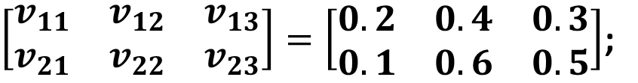
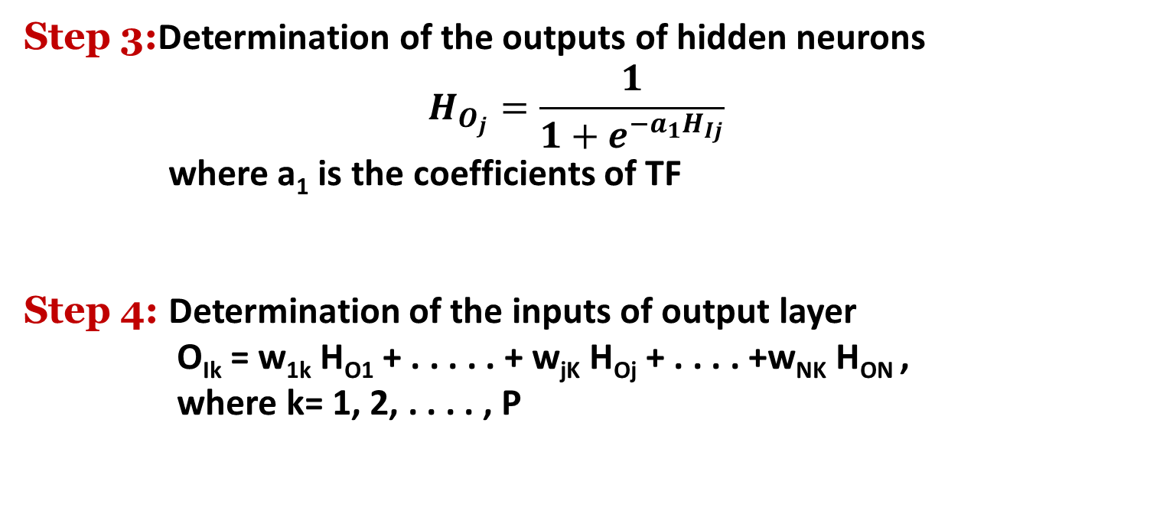
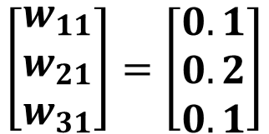
$\left[\begin{matrix}v_{11} & v_{12} & v_{13} \\ v_{21} & v_{22} & v_{23}\end{matrix}\right]=\left[\begin{matrix}0.2 & 0.4 & 0.3 \\ 0.1 & 0.6 & 0.5\end{matrix}\right]$;
Sl. No. | I₁ | I₂ | T_{O}
1 | 0.5 | -0.4 | 0.15
2 . . . | - . . . | - . . . | - . . .
$$\left[\begin{matrix}w_{11} \\ w_{21} \\ w_{31}\end{matrix}\right]=\left[\begin{matrix}0.1 \\ 0.2 \\ 0.1\end{matrix}\right]$$
Using an incremental mode of training for the case shown in the Table, calculate the changes in V (that is, $∆V$) and W (that is $∆W$) values during back-propagation of error, the learning rate $η$ is assumed to be equal to 0.2. Show only one iteration.

Slide 24
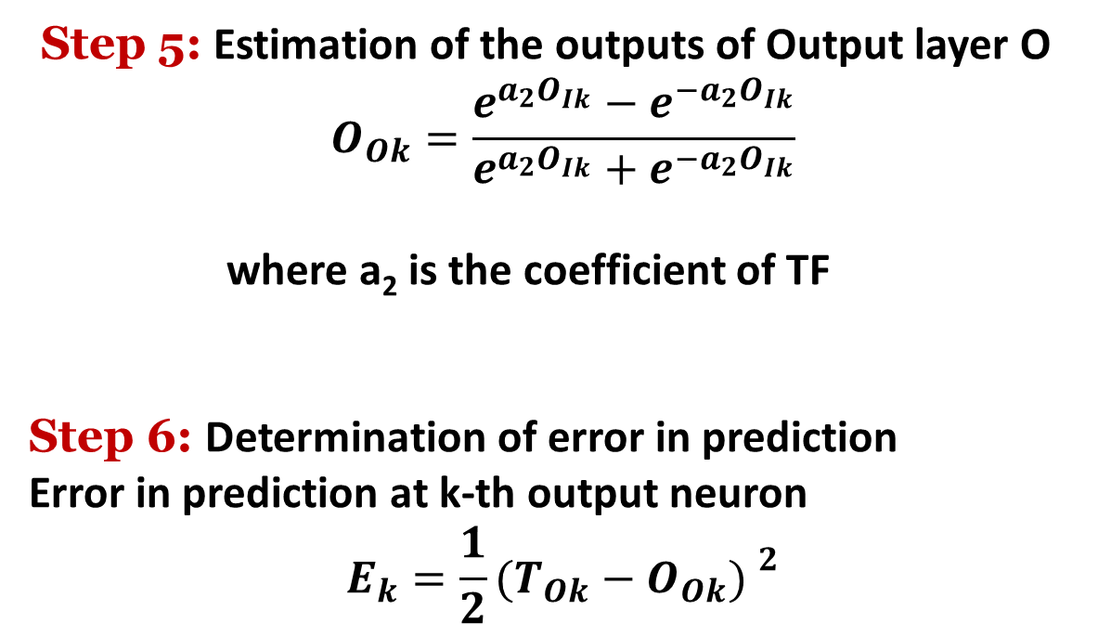
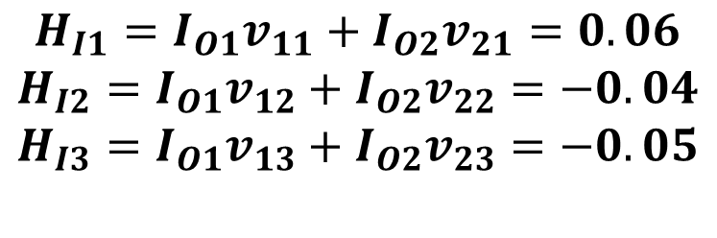
Solution:
Forward Calculations:
The neurons of input layer have linear transfer function (y=x). Therefore, the output of each input layer neuron is made equal to its corresponding input value.
$$I_{O1}=I_{I1}=0.5$$
$$I_{O2}=I_{I2}=−0.4$$
The inputs of different neurons of the hidden layer are calculated as follows:
$$H_{I1}=I_{O1}v_{11}+I_{O2}v_{21}=0.06$$
$$H_{I2}=I_{O1}v_{12}+I_{O2}v_{22}=−0.04$$
$$H_{I3}=I_{O1}v_{13}+I_{O2}v_{23}=−0.05$$

Slide 25
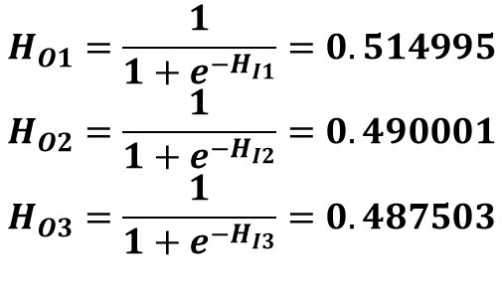
The neurons of the hidden layer are assumed to have log-sigmoid transfer function ($y=\frac{1}{1+e^{−x}}$). The outputs of different hidden neurons are determined like the following:
$$H_{O1}=\frac{1}{1+e^{−H_{I1}}}=0.514995$$
$$H_{O2}=\frac{1}{1+e^{−H_{I2}}}=0.490001$$
$$H_{O3}=\frac{1}{1+e^{−H_{I3}}}=0.487503$$

Slide 26
Now, the input of the output neuron can be calculated as follows:
$$O_{I1}=H_{O1}w_{11}+H_{O2}w_{21}+H_{O3}w_{31}=0.198249$$
As the output neuron has a tan-sigmoid transfer function, its output can be determined like the following:
$$O_{O1}=\frac{e^{OI1}−e^{−O_{I1}^{}}}{e^{OI1}{+e}^{−O_{I1}}}=0.195692$$
The squared error in prediction is found to be as follows:
$$E=\frac{1}{2}{(T_{O}−O_{O1})}^{2}=0.001044$$

Slide 27
Back-propagation Algorithm:
The change in $w_{11}$ can be determined using the procedure below.
$$∆w_{11}=−η\frac{∂E}{∂w_{11}},$$
$$\frac{∂E}{∂w_{11}}=\frac{∂E}{∂O_{O1}}\frac{∂O_{O1}}{∂O_{I1}}\frac{∂O_{I1}}{∂w_{11}}.$$
$$\frac{∂E}{∂O_{O1}}=−\left(T_{O}−O_{O1}\right)$$
$$\frac{∂O_{O1}}{∂O_{I1}}=\frac{4}{{(e^{OI1}{+e}^{−O_{I1}})}^{2}}$$
$$\frac{∂O_{I1}}{∂w_{11}}=H_{O1}.$$
where
Now,

Slide 28
Substituting the values of $T_{O}$, $O_{O1}$, $O_{I1},H_{O1}$in the last expression of $\frac{∂E}{∂w_{11}}$ we get
$$\frac{∂E}{∂w_{11}}=0.022630$$
Now, substituting the values of $\frac{∂E}{∂w_{11}}$ and $η$ in the expression of $∆w_{11},$we get
$$∆w_{11}=−0.004526$$
Similarly, we can determine $∆w_{21}$ and $∆w_{31}$ and these are found to be as follows:
$$∆w_{21}=−0.004306$$
$$∆w_{31}=−0.004284$$

Slide 29
The necessary change in $v_{11}$ can be obtained as follows:
$$∆v_{11}=−η\frac{∂E}{∂v_{11}}$$
$$\frac{∂E}{∂v_{11}}=\frac{∂E}{∂O_{O1}}\frac{∂O_{O1}}{∂O_{I1}}\frac{∂O_{I1}}{∂H_{O1}}\frac{∂H_{O1}}{∂H_{I1}}\frac{∂H_{I1}}{∂v_{11}}$$
where
$$\frac{∂E}{∂O_{O1}}=−\left(T_{O}−O_{O1}\right)$$
Now,
$$\frac{∂O_{O1}}{∂O_{I1}}=\frac{4}{{(e^{OI1}{+e}^{−O_{I1}})}^{2}}$$

Slide 30
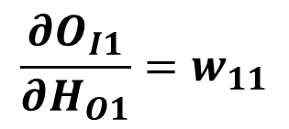
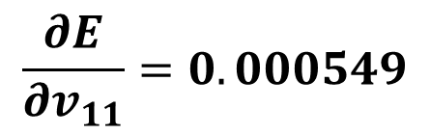

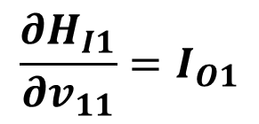
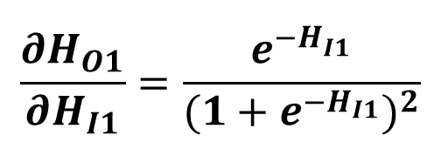
$$\frac{∂O_{I1}}{∂H_{O1}}=w_{11}$$
$$\frac{∂H_{O1}}{∂H_{I1}}=\frac{e^{−H_{I1}^{}}}{{(1+e^{−H_{I1}})}^{2}}$$
$$\frac{∂H_{I1}}{∂v_{11}}=I_{O1}$$
Substituting the values of $T_{O}$, $O_{O1}$, $O_{I1}, w_{11}, H_{I1}$and $I_{O1}$ in the last expression of $\frac{∂E}{∂v_{11}}$, we obtain
$$\frac{∂E}{∂v_{11}}=0.000549$$

Slide 31
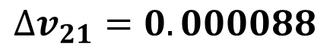
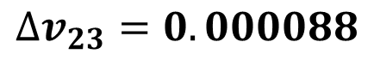
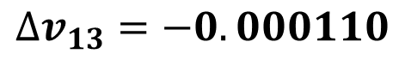
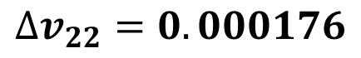
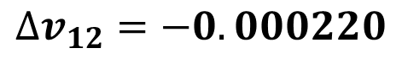
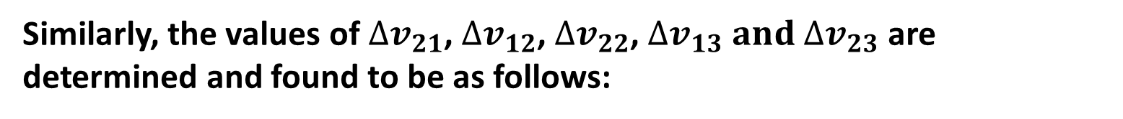
Now, substituting the values of $\frac{∂E}{∂v_{11}}$ and $η$, we get $∆v_{11}=−0.000110$
Similarly, the values of $∆v_{21}$, $∆v_{12}$, $∆v_{22}$, $∆v_{13} and$ $∆v_{23}$ are determined and found to be as follows:
$$∆v_{21}=0.000088$$
$$∆v_{12}=−0.000220$$
$$∆v_{22}=0.000176$$
$$∆v_{13}=−0.000110$$
$$∆v_{23}=0.000088$$

Slide 32
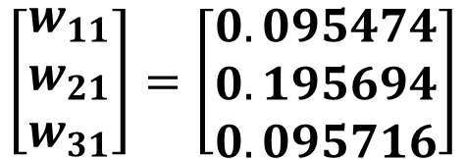
Therefore, the updated values of the weights are coming out to be as follows:
$\left[\begin{matrix}v_{11} & v_{12} & v_{13} \\ v_{21} & v_{22} & v_{23}\end{matrix}\right]=\left[\begin{matrix}0.199890 & 0.399780 & 0.299890 \\ 0.100088 & 0.600176 & 0.500088\end{matrix}\right]$;
$$\left[\begin{matrix}w_{11} \\ w_{21} \\ w_{31}\end{matrix}\right]=\left[\begin{matrix}0.095474 \\ 0.195694 \\ 0.095716\end{matrix}\right]$$

Slide 33
Radial Basis Function Network (RBFN)
Radial Basis Function
A special type of function, whose response decreases or increases monotonically with its distance from a central point

Slide 34
Various types of Radial Basis Function:
Thin plate spline function: f(x) = x²logx
Gaussian function: f(x) = $exp\left(−\frac{{\left\|x−μ\right\|}^{2}}{2σ^{2}}\right)=exp\left(−\frac{1}{2}{\left(\frac{x−μ}{σ}\right)}^{2}\right)$
Multi-quadratic function: f(x) = $\sqrt{x^{2}+σ^{2}}$
Inverse multi-quadratic function: f(x) = $\frac{1}{\sqrt{x^{2}+σ^{2}}}$

Slide 35
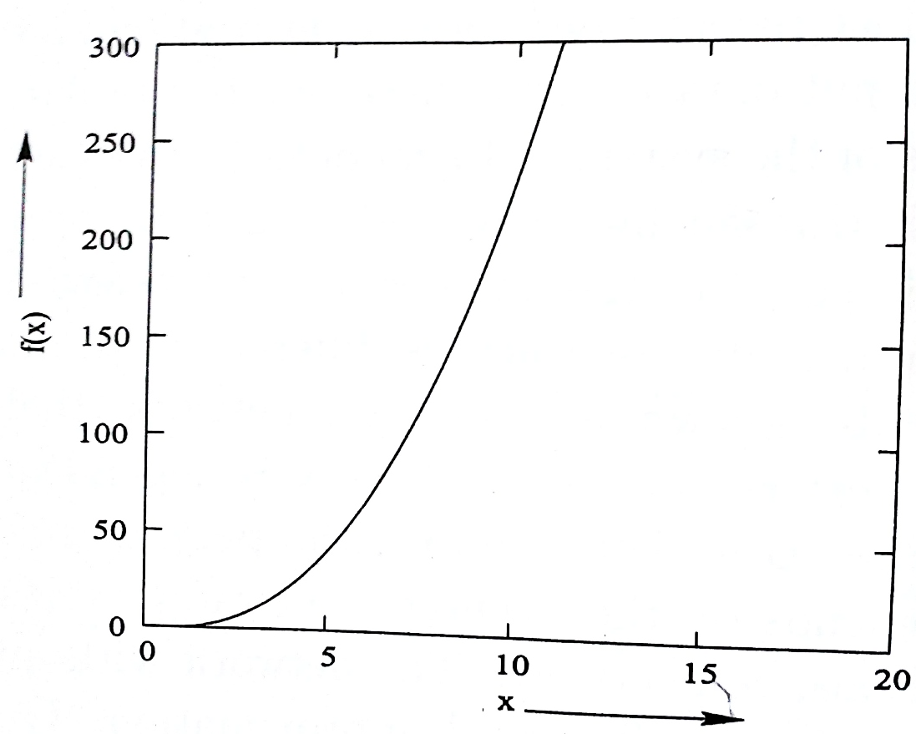
Radial Basis Functions
Thin Plate Spline

Slide 36
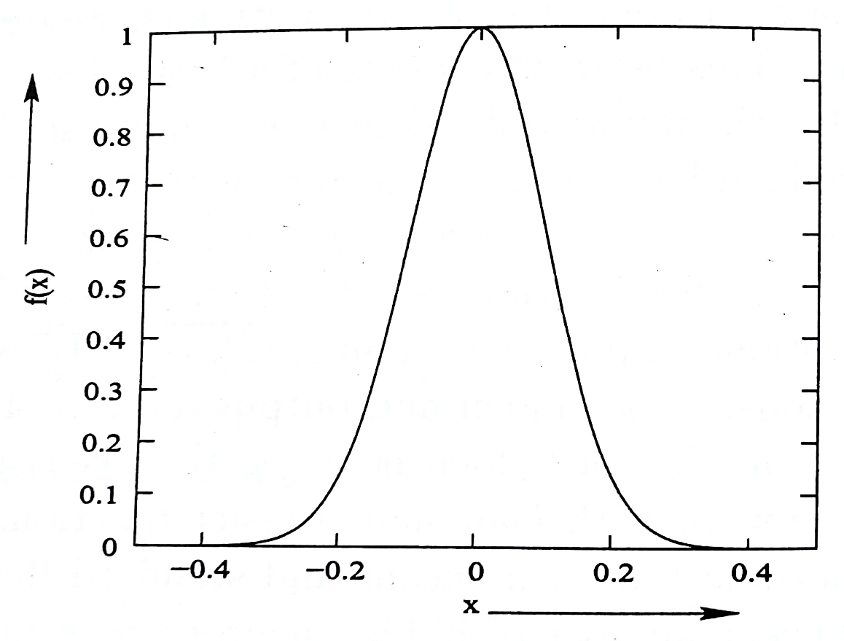
Gaussian Function

Slide 37
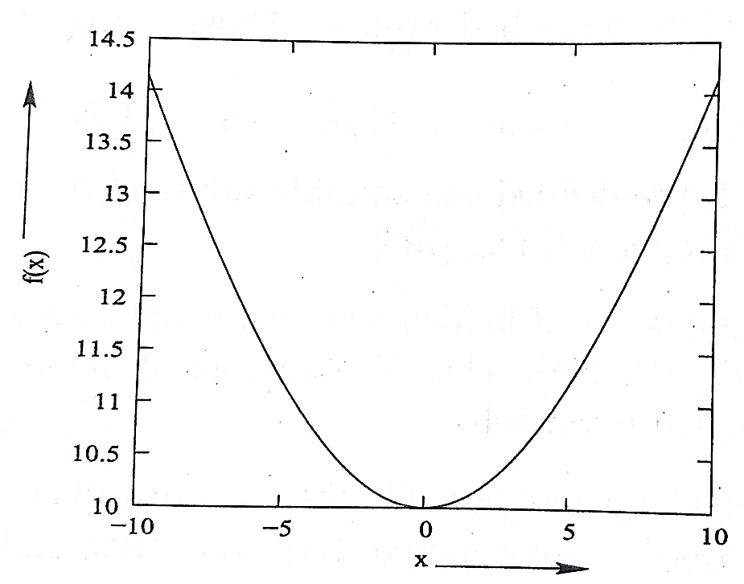
Radial Basis Functions
Multi-quadratic function
Multi-quadratic function
Inverse Multi-quadratic function

Slide 38
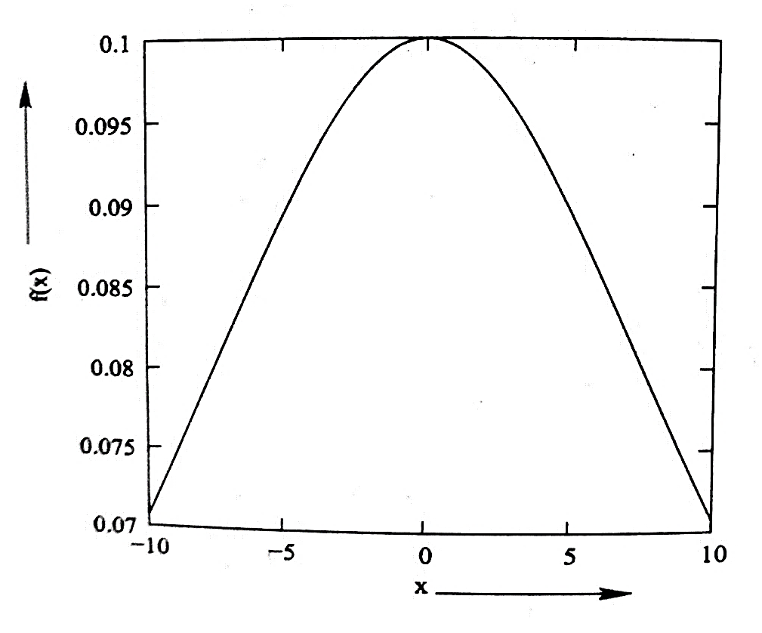
Radial Basis Functions
Inverse Multi-quadratic function
Multi-quadratic function
Inverse Multi-quadratic function

Slide 39
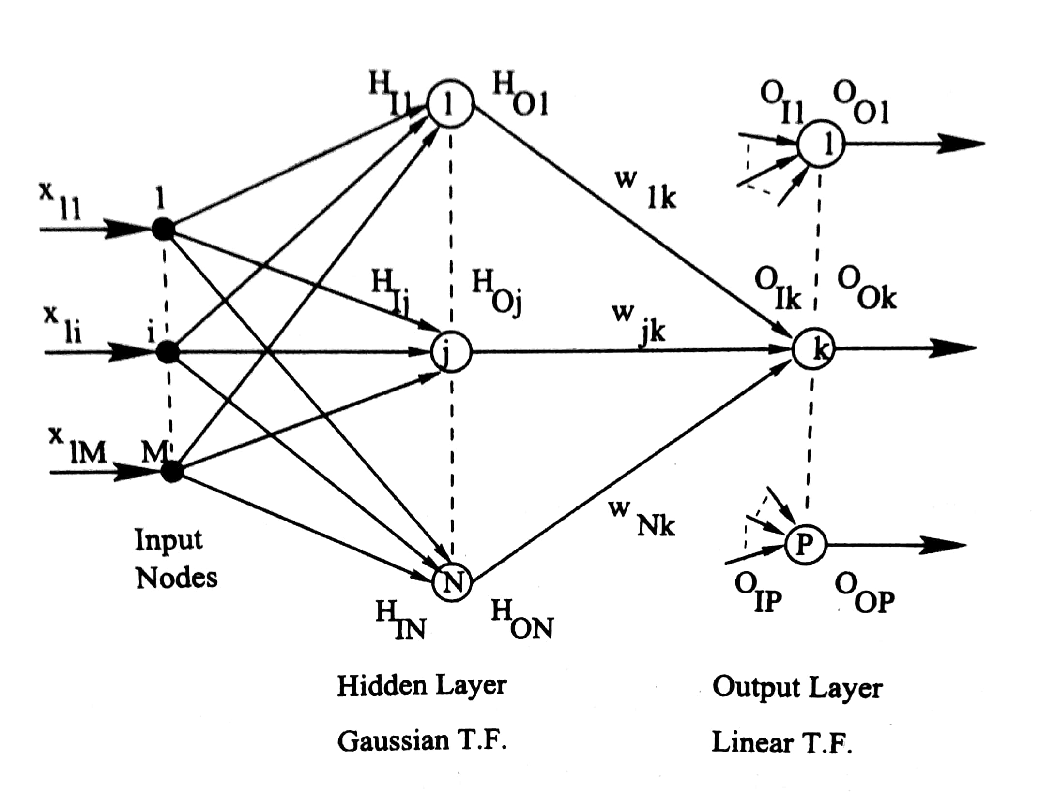
Radial Basis Function Neural Network (RBFNN)

Slide 40
Forward Calculations
Step 1:
Determination of the outputs of input nodes
Let us consider L training scenarios.
Input vector
x₁ x₁₁ x₁₂ . . . . x_{1i} . . . . x_{1M}
x₂ x₂₁ x₂₂ . . . . x_{2i} . . . . x_{2M}
. . . . . . . . . . . . .
X = . = . . . . . . . . . . . .
x_{l} x_{l1} x_{l2} . . . . x_{li} . . . . x_{lM}
. . . . . . . . . . . . .
. . . . . . . . . . . . .
x_{L} x_{L1} x_{L2} . . . . x_{Li} . . . . x_{LM}

Slide 41
Let us assume that l-th training scenario (that is, x_{l1}, x_{l2}, . . . , x_{li}, . . . ., x_{lM}) is passed through the network. Outputs of different nodes of the input layer are nothing but the inputs of corresponding nodes.
Determination of the outputs of hidden layer
Output of j-th hidden neuron
Step 2:

Slide 42
Step 3:
Step 4:
Determination of the inputs of output layer
Input of k-th neuron lying on output layer
Determination of the outputs of the output layer
O_{Ok} = O_{ik}
Error in prediction of k-th output neuron
E_{k} = ½ (T_{Ok} – O_{Ok})²

Slide 43
Tuning of RBFNN Using BP Algorithm
Incremental Mode of Training
Step 1: Weight Updating
w_{updated} = w_{previous} + Δw
Now,
Where

Slide 44
Here

Slide 45
Step 2: Mean Updating
μ_{j,updated} = μ_{j,previous} + Δμ_{j}
Now,
Where,
Now,

Slide 46
Now,

Slide 47
Step 3: Standard Deviation Updating
σ_{j,updated} = σ_{j,previous} + Δσ_{j}
Now,
where

Slide 48
Now,

Slide 49
Numerical Example
A radial basis function neural network (RBFNN) is to be used to model input-output relationships of an engineering process having four inputs and one output, as shown in Figure.

Slide 50
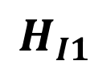
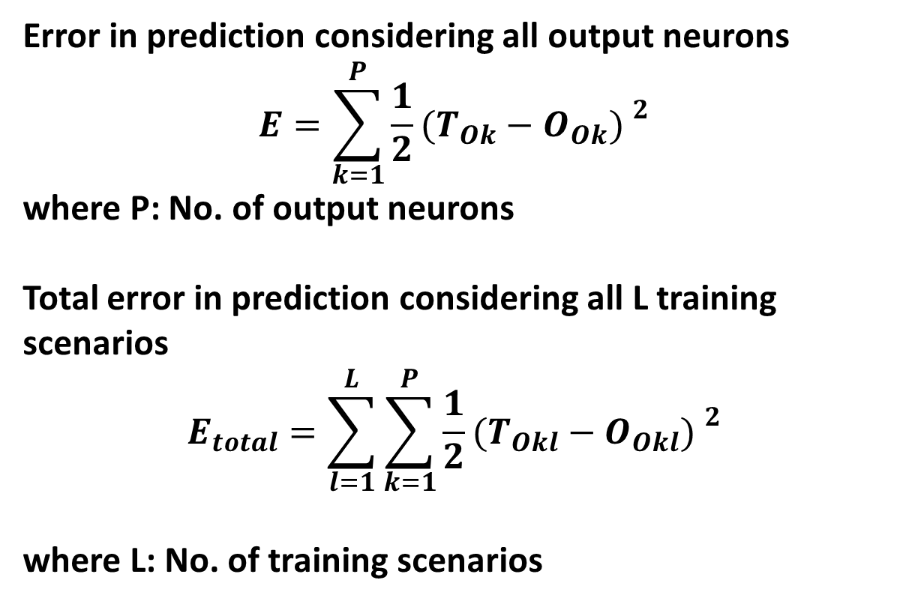
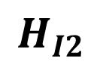
1
$$H_{I1}$$
$$x_{I1}$$
1
$$H_{O1}$$
$$W_{11}$$
$$x_{I2}$$
2
$$H_{I2}$$
$$O_{I1}$$
$$W_{21}$$
2
1
O
$$x_{I3}$$
3
$$H_{O2}$$
$$O_{O1}$$
$$W_{31}$$
Output Layer
Linear T.F.
$$H_{I3}$$
$$x_{I4}$$
4
3
$$H_{O3}$$
Input Nodes
Hidden Layer
Inverse multi-quadratic function

Slide 51
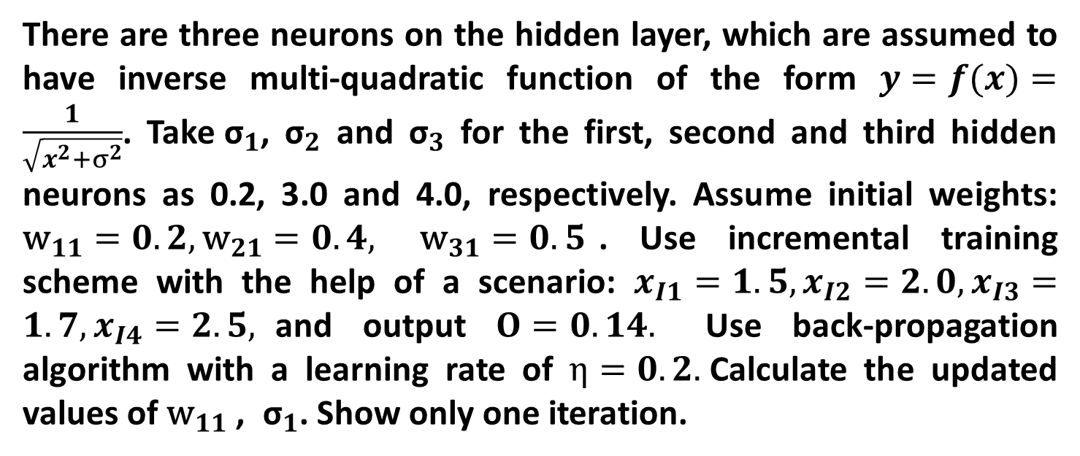
There are three neurons on the hidden layer, which are assumed to have inverse multi-quadratic function of the form $y=f(x)=\frac{1}{\sqrt{x^{2}+σ^{2}}}$. Take${ \text{σ}}_{1}$, ${\text{σ}}_{2}$ and ${\text{σ}}_{3}$ for the first, second and third hidden neurons as 0.2, 3.0 and 4.0, respectively. Assume initial weights: ${\text{w}}_{11}=0.2, {\text{w}}_{21}=0.4,$ ${\text{w}}_{31}=0.5$. Use incremental training scheme with the help of a scenario: $x_{I1}=1.5, x_{I2}=2.0, x_{I3}=1.7, x_{I4}=2.5,$and output $O=0.14.$ Use back-propagation algorithm with a learning rate of $η=0.2.$Calculate the updated values of ${\text{w}}_{11}$ , ${ \text{σ}}_{1}$. Show only one iteration.

Slide 52
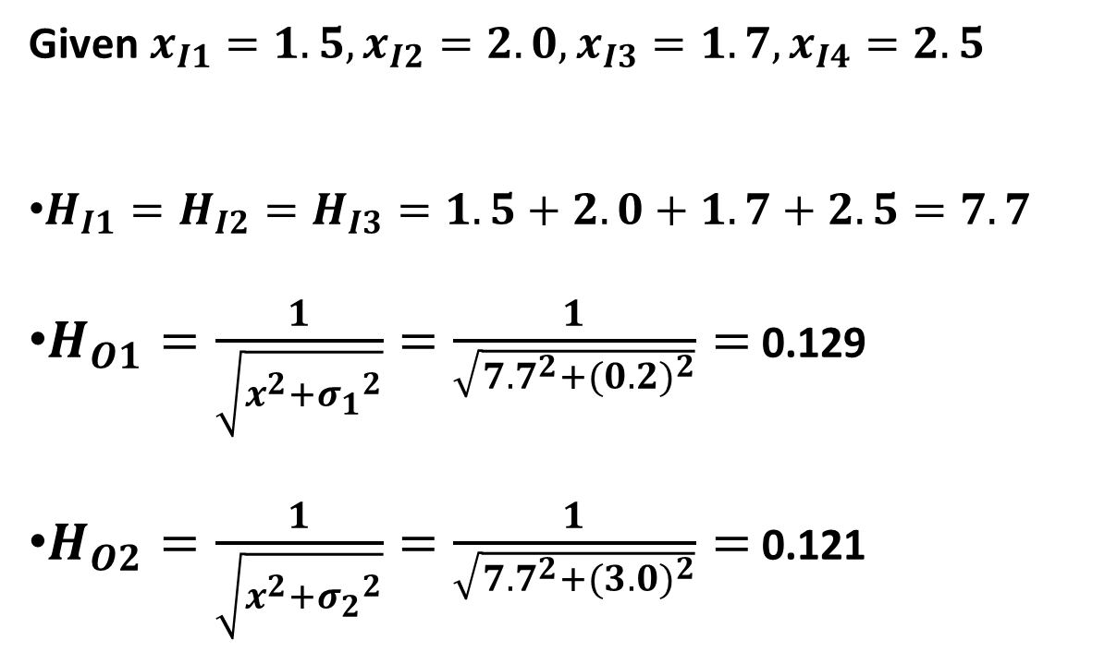
Solution
Given $x_{I1}=1.5, x_{I2}=2.0, x_{I3}=1.7, x_{I4}=2.5$
$H_{I1}=H_{I2}=H_{I3}=1.5+2.0+1.7+2.5=7.7$
$H_{O1}=\frac{1}{\sqrt{x^{2}+{σ_{1}}_{}^{2}}}=\frac{1}{\sqrt{{7.7}^{2}+{(0.2)}^{2}}}=$ 0.129
$H_{O2}=\frac{1}{\sqrt{x^{2}+{σ_{2}}_{}^{2}}}=\frac{1}{\sqrt{{7.7}^{2}+{(3.0)}^{2}}}=$ 0.121

Slide 53
$H_{O3}=\frac{1}{\sqrt{x^{2}+{σ_{3}}_{}^{2}}}=\frac{1}{\sqrt{{7.7}^{2}+{(4.0)}^{2}}}=$ 0.115
${O_{I1}\text{=}H_{O1}× \text{w}}_{11}$ + ${H_{O2}× \text{w}}_{21}$ + ${H_{O3}× \text{w}}_{31}$
$\text{=}$ 0.129 $×$0.2 + 0.121 $×$ 0.4 + 0.115 $×$ 0.5 $\text{=}$ 0.1317
$∴ O_{O1}\text{=}$0.1317

Slide 54
Now, ${\text{w}}_{11}$ (updated) $\text{=}$ ${\text{w}}_{11}$ (previous) + ${∆\text{w}}_{11}$
${∆\text{w}}_{11}$ $\text{=}$ $−$η$\frac{∂E}{∂{\text{w}}_{11}}$
$\text{Now}\text{,} \frac{∂E}{∂{\text{w}}_{11}}\text{=}$ $\frac{∂E}{∂O_{O1}}$ $×$ $\frac{∂O_{O1}}{∂O_{I1}}$ $×\frac{∂O_{I1}}{∂{\text{w}}_{11}}$
$\text{=}$ $−$ ($T_{O1}$ $−O_{O1}$) $×$ 1 $×$ $H_{O1}$
$\text{=}$ $−$ (0.14 $−$0.1317) $×$ 1 $×$ $0.129$ $\text{=}$ $−$ 0.00107

Slide 55
$∴ {∆\text{w}}_{11}$ $\text{=}$ $−$0.2 $×$ ($−$0.00107) $\text{=}$ $0.000214$
${\text{w}}_{11}$ (updated) $\text{=}$ $0.2$ + $0.000214$ $\text{=}$ 0.200214
Similarly, ${\text{w}}_{21}$ (updated) and ${\text{w}}_{31}$ (updated) can be determined.

Slide 56
${\text{σ}}_{1}$ (updated) $\text{=}{\text{σ}}_{1}$ (previous) + ${∆\text{σ}}_{1}$
${∆\text{σ}}_{1}\text{=}−$η$\frac{∂E}{∂σ_{1}}$
Now, $\frac{∂E}{∂σ_{1}}\text{=}$ $\text{=}$ $\frac{∂E}{∂O_{O1}}$ $×$ $\frac{∂O_{O1}}{∂O_{I1}}$ $×\frac{∂O_{I1}}{∂H_{O1}}$ $×\frac{∂H_{O1}}{∂σ_{1}}$
$\frac{∂H_{O1}}{∂σ_{1}}=\frac{∂\left(\frac{1}{\sqrt{x^{2}+{σ_{1}}^{2}}}\right)}{∂σ_{1}}=−\frac{1}{2}{\left(x^{2}+{σ_{1}}^{2}\right)}^{−\frac{3}{2}}×$ 2$σ_{1}$
$\text{=}$ $−{\left(x^{2}+{σ_{1}}^{2}\right)}^{−\frac{3}{2}}×$ $σ_{1}$

Slide 57
Now, $\frac{∂E}{∂σ_{1}}\text{=}$ $−(T_{O1}−O_{O1})×$ 1 $×w_{11}×\left\{−{\left({H_{I1}}^{2}+{σ_{1}}^{2}\right)}^{−\frac{3}{2}}{×σ}_{1}\right\}$
$=−(0.14−0.1317)$ $×$ 1 $×$0.2 $×$ $\left\{−{\left({7.7}^{2}+{0.2}^{2}\right)}^{−\frac{3}{2}}×0.2\right\}$
$\text{=}$ $7.26$ $×$ ${10}^{−7}$
$∴ {∆\text{σ}}_{1}\text{=}−$η$\frac{∂E}{∂σ_{1}}\text{=}$ $−$0.2 $×$7.26 $×$ ${10}^{−7}\text{=}$ $−$1.45$×$ ${10}^{−7}$

Slide 58
${∴\text{σ}}_{1}$ (updated) $\text{=}{\text{σ}}_{1}$ (previous) + ${∆\text{σ}}_{1}$
$=$ 0.2 $−$ $1.45×$ ${10}^{−7}$
$=$ 0.199999
Similarly, the updated values of ${\text{σ}}_{2}$ and ${\text{σ}}_{3}$ can be determined.

